Slide 1
Phase Transition

Slide 2
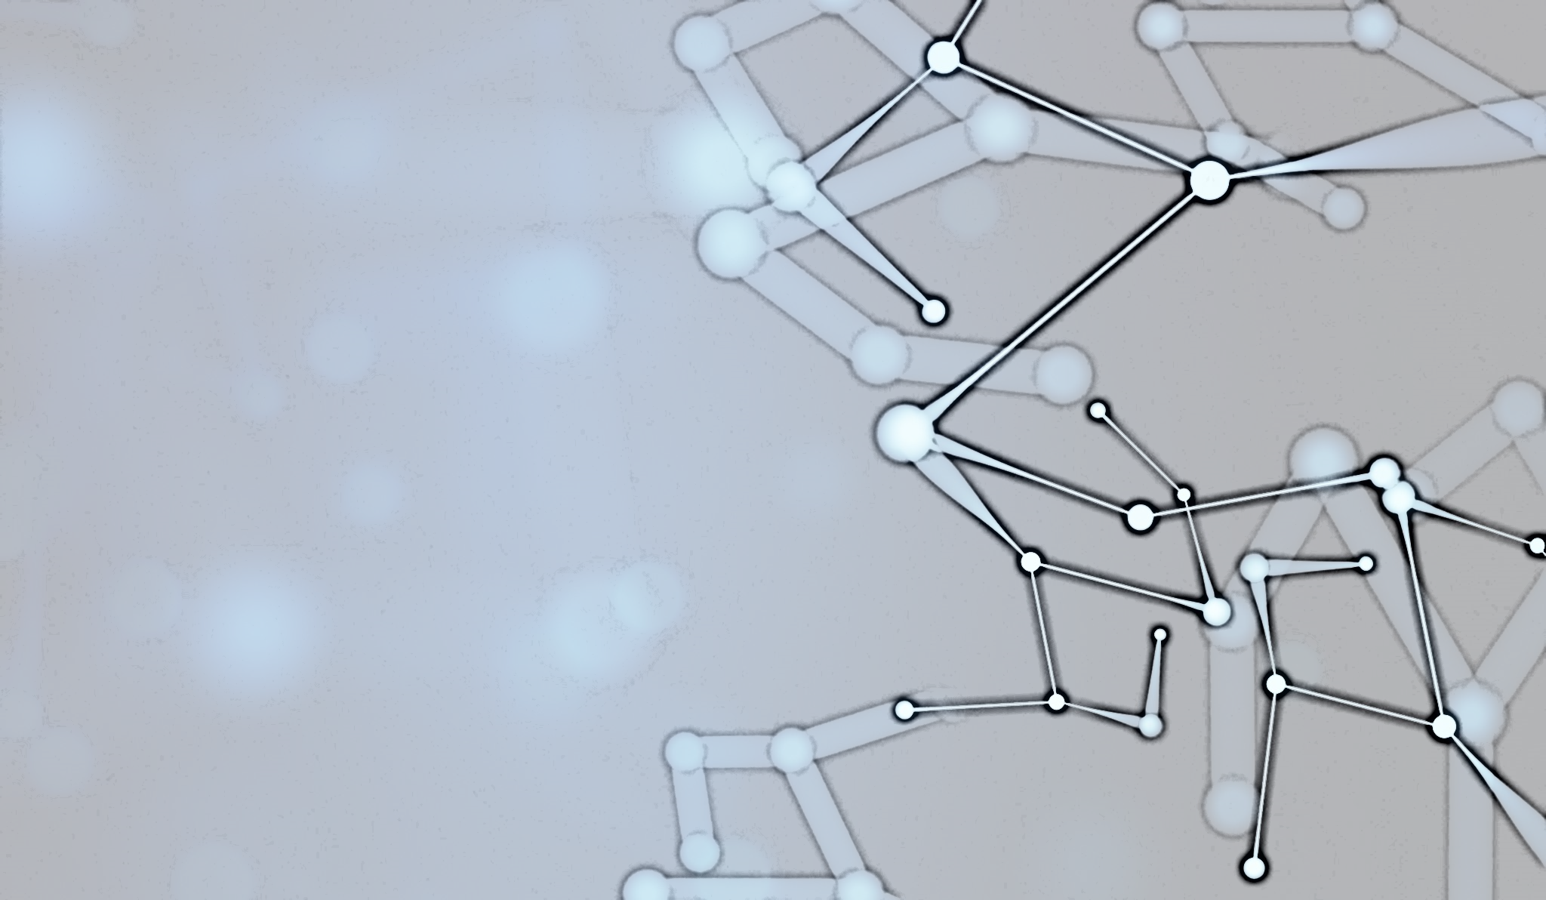
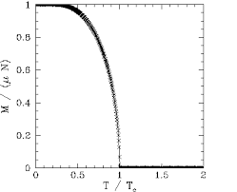
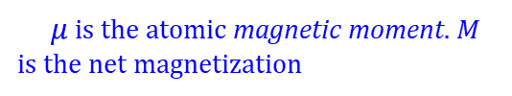
$μ$ is the atomic magnetic moment. $M$ is the net magnetization

Slide 4
Percolation Theory

Slide 5
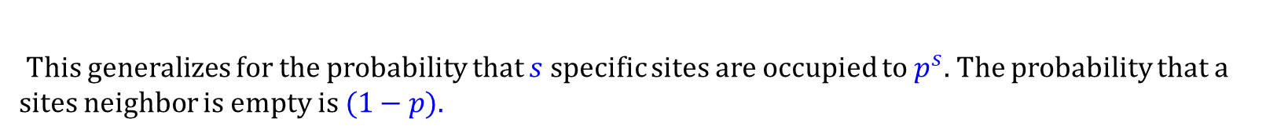
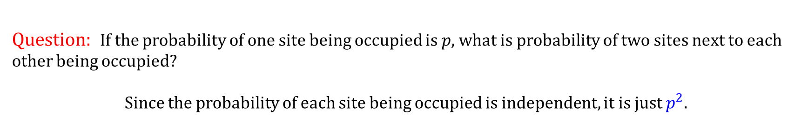
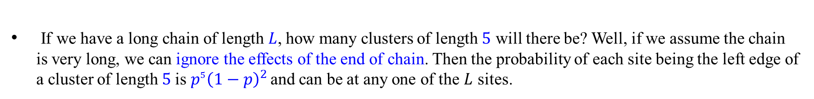
Percolation in 1-d
Question: If the probability of one site being occupied is $p$, what is probability of two sites next to each other being occupied?
Since the probability of each site being occupied is independent, it is just $p^{2}$.
This generalizes for the probability that $s$ specific sites are occupied to $p^{s}$. The probability that a sites neighbor is empty is $(1−p).$
Combining the above results, the probability a site is the left edge of a cluster of length $s$ is $p^{s}{\left(1−p\right)}^{2}$.
If we have a long chain of length $L$, how many clusters of length $5$ will there be? Well, if we assume the chain is very long, we can ignore the effects of the end of chain. Then the probability of each site being the left edge of a cluster of length $5$is $p^{5}{\left(1−p\right)}^{2}$and can be at any one of the $L$ sites.

Slide 6
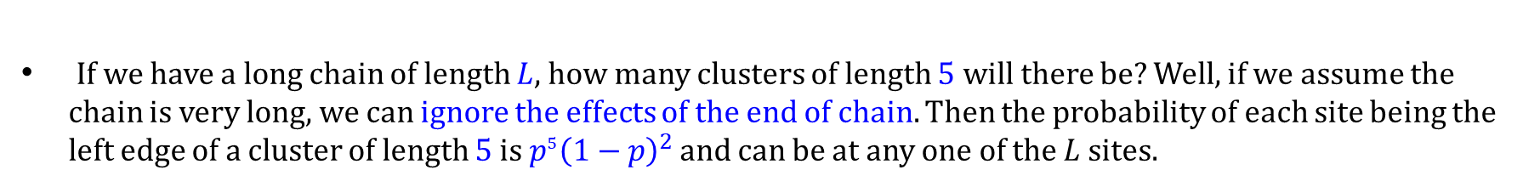
Percolation in 1-d
If we have a long chain of length $L$, how many clusters of length $5$ will there be? Well, if we assume the chain is very long, we can ignore the effects of the end of chain. Then the probability of each site being the left edge of a cluster of length $5$is $p^{5}{\left(1−p\right)}^{2}$and can be at any one of the $L$ sites.
Thus the total number of clusters of size $5$ is ${p^{5}\left(1−p\right)}^{2}×L$. It is normally more practical to talk about the number of clusters per lattice site, which is the above expression divided by L, or just ${p^{5}\left(1−p\right)}^{2}$.
Thus, for clusters of $s$ sites, we define $n_{s}$, normalized cluster, as the number of clusters with size $s$per lattice site.

Slide 7
Percolation in 1-d
If we have a long chain of length $L$, how many clusters of length $5$ will there be? Well, if we assume the chain is very long, we can ignore the effects of the end of chain. Then the probability of each site being the left edge of a cluster of length $5$is $p^{5}{\left(1−p\right)}^{2}$and can be at any one of the $L$ sites.
Thus the total number of clusters of size $5$ is ${p^{5}\left(1−p\right)}^{2}×L$. It is normally more practical to talk about the number of clusters per lattice site, which is the above expression divided by L, or just ${p^{5}\left(1−p\right)}^{2}$.
Thus, for clusters of $s$ sites, we define $n_{s}$, normalized cluster, as the number of clusters with size $s$per lattice site.
The probability that a site is a part of a cluster of size $s$ is actually higher than the normalized cluster number, because it does not have to be at the left end. It can be at any of the s sites. Therefore, the probability a single site is in a cluster of size $s$is $n_{s}×s$.
Since all sites have equal probability of being occupied (or empty), the probability that an arbitrary site is part of an $s$-cluster is $s$ times the probability of it being the LHS of the cluster.

Slide 8
Percolation in 1-d
Since all sites have equal probability of being occupied (or empty), the probability that an arbitrary site is part of an $s$-cluster is $s$ times the probability of it being the LHS of the cluster.
Q: Show that (in 1-d lattice), normalized cluster defined as the number of clusters with size $s$per lattice site can be written as
n_s(p)=(1-p)^2 p^s. Prove that cut-off cluster size is s_\xi=(p_c-p)^-1. Here the probability of one site being occupied is 𝑝

Slide 9
Percolation in 1-d

Slide 10
Percolation in 1-d
Q: Show that (in 1-d lattice), normalized cluster defined as the number of clusters with size $s$per lattice site can be written as
n_s(p)=(1-p)^2 p^s. Prove that cut-off cluster size is s_\xi=(p_c-p)^-1. Show that sum(s n_s)=p
Here the probability of one site being occupied is 𝑝.

Slide 11
Cluster Size - 1D
In order to discuss clusters, we need some definitions.
This is most easily done in ONE dimension because exact solutions are available for 1D (but not, of course, for higher dimensions!): every site must be occupied for percolation, so p_{c} = 1!
“n_{s}” is the number of clusters per lattice site of size s. Note how the definition is given in terms of each individual site. This quantity is also called the normalized cluster number.
The probability that a given lattice site is a member of a cluster of size s is given by the product of the cluster size and n_{s}.
These probabilities are related to the occupation probability in a simple way: p_{s} = Σ_{s}n_{s}s.
[Stauffer p. 21]

Slide 12
Cluster Size - 1D
The probability, n_{s}, that a given site belongs to a cluster of size s, is given by dividing the probability that that site belongs to that size class, w_{s}, and dividing it by the occupation probability, p_{s}: w_{s} = n_{s}s / p_{s} = n_{s}s / Σ_{s}n_{s}s.
Thus, the average cluster size, S, is given by: S = Σ_{s}w_{s}s = Σ_{s}{n_{s}s²/ Σ_{s}n_{s}s}.
This definition of cluster size is also valid for higher dimensions (d>1) although the infinite cluster must be excluded from the sums.
Lattice animals are very similar but derived from graph theory.

Slide 13
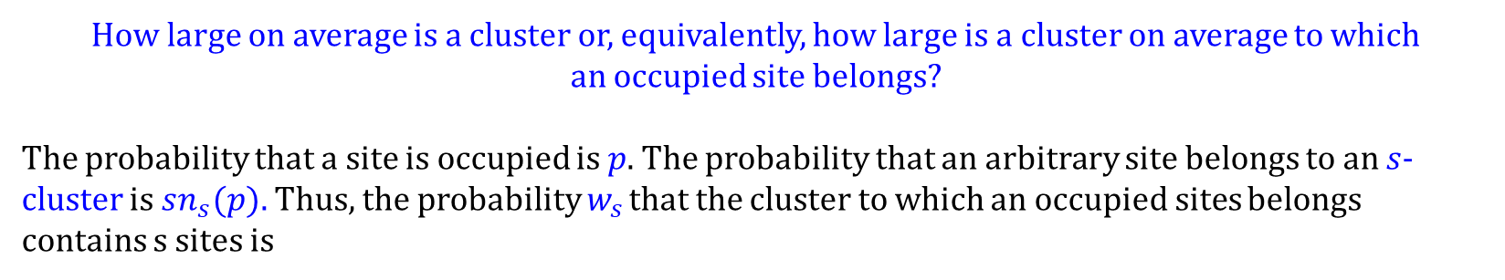
Percolation in 1-d
How large on average is a cluster or, equivalently, how large is a cluster on average to which
an occupied site belongs?
The probability that a site is occupied is $p$. The probability that an arbitrary site belongs to an $s$-cluster is $sn_{s}(p).$Thus, the probability $w_{s}$ that the cluster to which an occupied sites belongs contains s sites is
Which is in some sense a "weighting" of relative cluster sizes.

Slide 14
Percolation in 1-d

Slide 15
Percolation in 1-d

Slide 16
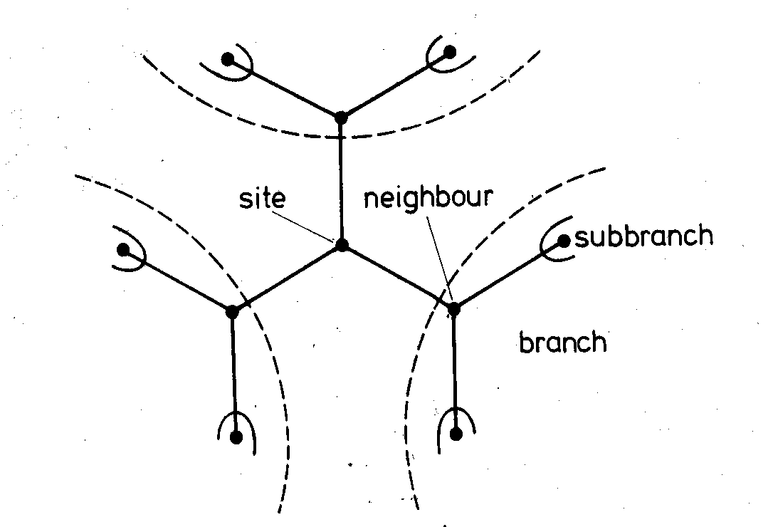
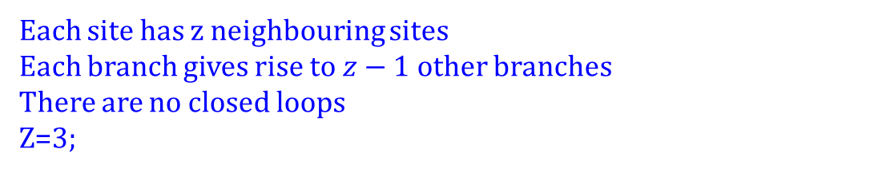
Percolation in Bethe Lattice
Each site has z neighbouring sites
Each branch gives rise to $z−1$ other branches
There are no closed loops
Z=3;

Slide 17
Percolation in Bethe Lattice
Q. Prove that, a) the number of surface sites relative to the total number of sites approaches a constant.
Each site has z neighbouring sites
Each branch gives rise to $z−1$ other branches
There are no closed loops
Z=3;

Slide 18
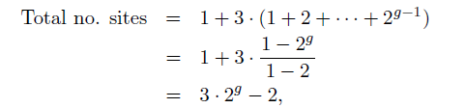
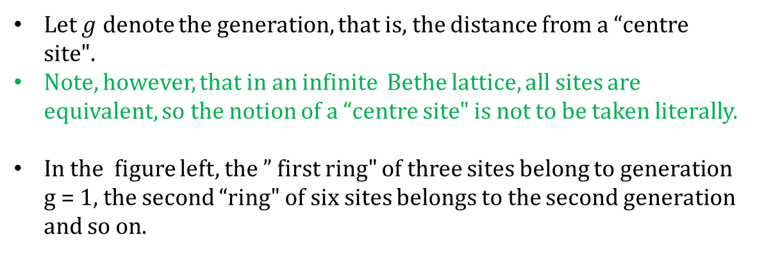
Percolation in Bethe Lattice
Q. Prove that, a) the number of surface sites relative to the total number of sites approaches a constant.
Let $g$ denote the generation, that is, the distance from a “centre site".
Note, however, that in an infinite Bethe lattice, all sites are equivalent, so the notion of a “centre site" is not to be taken literally.
In the figure left, the ” first ring" of three sites belong to generation g = 1, the second “ring" of six sites belongs to the second generation and so on.
The total number of sites in a Bethe lattice consisting of $g$ generations is

Slide 19
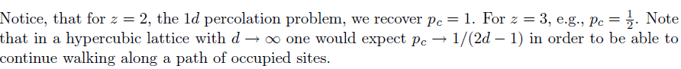
Percolation in Bethe Lattice
Q. Prove that, a) the number of surface sites relative to the total number of sites approaches a constant.

Slide 20
Percolation in Bethe Lattice

Slide 21
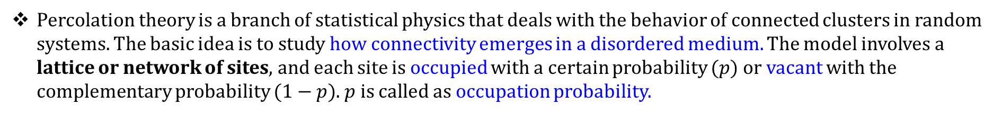
Percolation Theory (in 2-d)
Percolation theory is a branch of statistical physics that deals with the behavior of connected clusters in random systems. The basic idea is to study how connectivity emerges in a disordered medium. The model involves a lattice or network of sites, and each site is occupied with a certain probability $(p)$or vacant with the complementary probability $(1−p)$. $p$ is called as occupation probability.

Slide 22
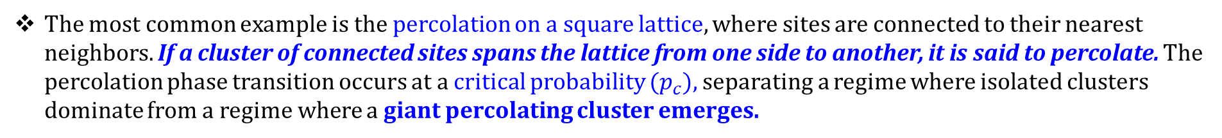
Percolation Theory
Percolation theory is a branch of statistical physics that deals with the behavior of connected clusters in random systems. The basic idea is to study how connectivity emerges in a disordered medium. The model involves a lattice or network of sites, and each site is occupied with a certain probability $(p)$or vacant with the complementary probability $(1−p)$. $p$ is called as occupation probability.
The most common example is the percolation on a square lattice, where sites are connected to their nearest neighbors. If a cluster of connected sites spans the lattice from one side to another, it is said to percolate. The percolation phase transition occurs at a critical probability $(p_{c}),$separating a regime where isolated clusters dominate from a regime where a giant percolating cluster emerges.

Slide 23
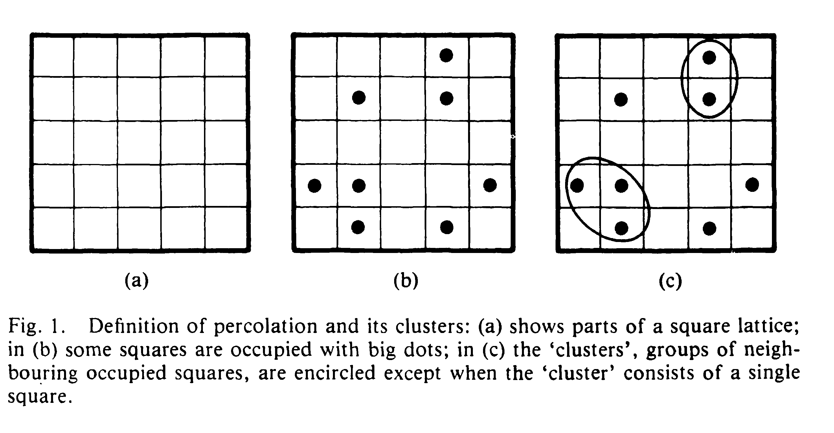
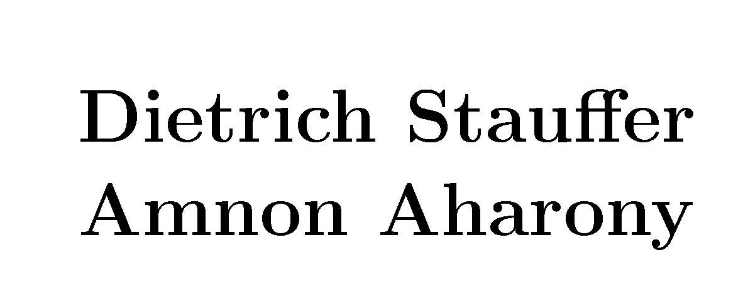

Slide 24
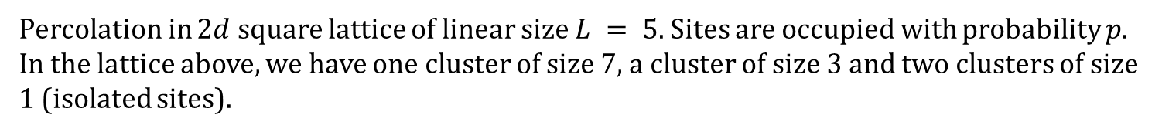
Percolation Theory (contd.)
Percolation in $2d$ square lattice of linear size $L = 5.$Sites are occupied with probability $p$. In the lattice above, we have one cluster of size 7, a cluster of size 3 and two clusters of size 1 (isolated sites).
A cluster is a group of nearest neighbouring occupied sites.
Dr. Kim Christensen

Slide 25



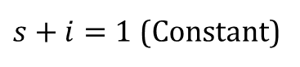

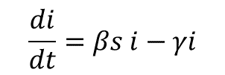

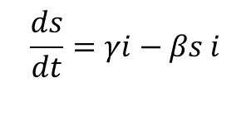

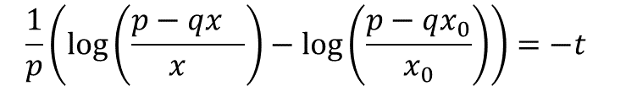
Epidemic Spreading : Modelling
SIS Dynamics
$$\frac{ds}{dt}=γi−βs i$$
$$\frac{1}{p}\left(\log\left(\frac{p−qx_{}}{x_{}}\right)−\log\left(\frac{p−qx_{0}}{x_{0}}\right)\right)=−t$$
$$\frac{di}{dt}=βs i−γi$$
$$p=\left(β−γ\right);q=β$$
$s+i=1$ (Constant)
$$\left(\frac{p−qx_{}}{x_{}}\right)=e^{−pt}(\frac{p−qx_{0}}{x_{0}})$$
$$\frac{p}{x}=q+e^{−pt}(\frac{p−qx_{0}}{x_{0}})$$
$$x=\frac{p}{q+e^{−pt}(\frac{p−qx_{0}}{x_{0}}) }$$

Slide 26
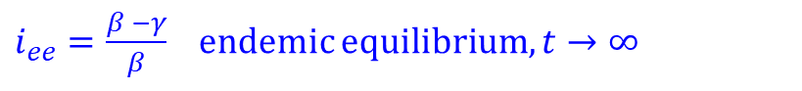
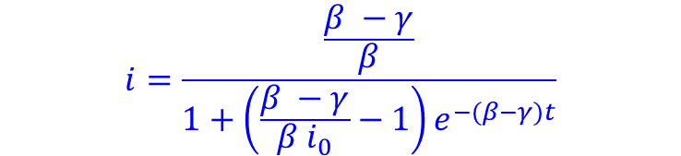
Epidemic Spreading : Modelling
SIS Dynamics
$$\frac{ds}{dt}=γi−βs i$$
$$\frac{di}{dt}=βs i−γi$$
$$p=\left(β−γ\right);q=β$$
$s+i=1$ (Constant)
$$i=\frac{\frac{β −γ}{β}}{1+\left(\frac{β −γ}{β i_{0}}−1\right)e^{−(β−γ)t}}$$
$i_{ee}=\frac{β −γ}{β}$ endemic equilibrium, $t→∞$

